Slide 1
Digital Image Processing
Associate Prof. Zhang Qingfeng(张庆丰)
Department of Computer Science, Jinan University
Office Room: 410, Nanhailou Building
Email: zqf135@qq.com

Slide 2
Chapter 6
Color Image Processing

Slide 3
Contents
Overview
Color Fundamentals
Color Models
Pseudocolor Image Processing
Color Transformations
Smoothing and Sharpening
Color Segmentation
Summary
3

Slide 4
Overview of Color Image Processing
Motivations (Why do we need use color)
For human interpretation
human can discern thousands of colors! (versus grey)
For automated image analysis
more information for objects!
Two major areas
Full-color processing
generated by full-color TV camera or color scanner
Pseudocolor processing
generated by assigning color to monochrome images
4

Slide 5
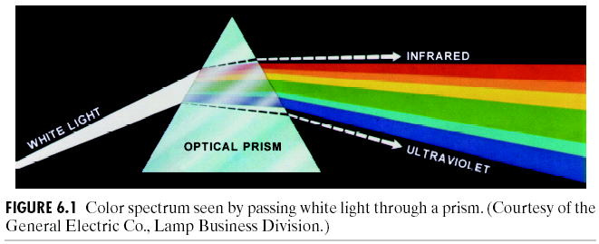
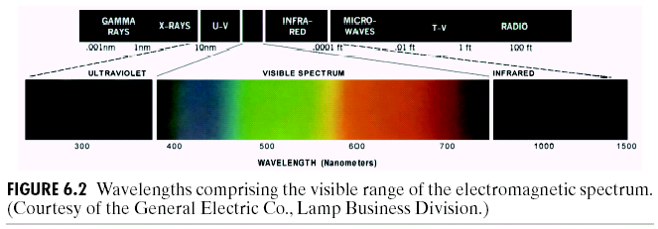
Color Fundamentals
The nature of light and colors
Light: from violet to red
Color spectrum – violet, blue, green, yellow, red
5

Slide 6
Color Fundamentals
The nature of light and colors (Cnt’d)
Quality of a chromatic light source
radiance (辐射度) – energy flowed
luminance (光通量) – energy received
brightness (亮度) – subjective descriptor of intensity
Primary colors of light
red (R), green (G), blue (B)
consistent with color perception of human eyes
Any color can be created by combing RGB?
Secondary colors of light
magenta (品红、洋红) (red+blue), cyan（青色） (green+blue), yellow (red+green)
6

Slide 7
Color Fundamentals
The nature of light and colors (Cnt’d)
Primary and secondary colors of pigments (颜料)
primary : magenta, cyan, yellow
secondary : red (R), green (G), blue (B)
Difference between primary colors of
light :
additive nature, example: color TV
pigment :
subtractive nature, example: color printing
7

Slide 8
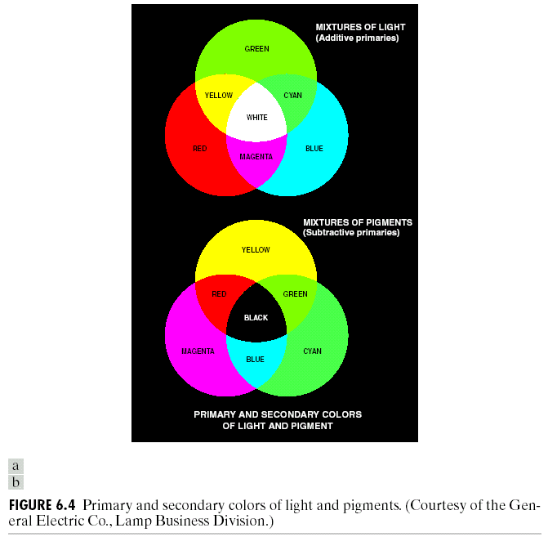
Color Fundamentals
The nature of light and colors (Cnt’d)
8

Slide 9
Color Fundamentals
The nature of light and colors (Cnt’d)
Color characteristics
brightness (亮度): chromatic notion of intensity
hue (色调) : dominant wavelength
saturation (饱和度) : relative purity or white mixed
example: pink (red + white), lavendar (violet + white)
chromaticity (色度) : hue + saturation
Tristimulus values and trichromatic coefficients
tristimulus values (三色激励值): X, Y, Z
trichromatic coefficients (三色系数): x, y, z
9

Slide 10
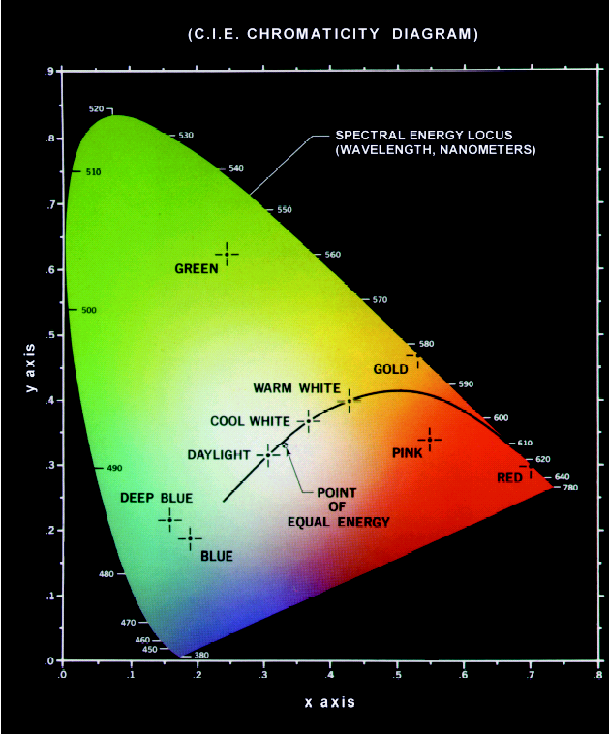
Color Fundamentals
CIE Chromaticity Diagram
for specifying colors
boundary : spectrum colors!
color mixing:
a straight-line segment jointing any two points can generate different color variations by combining these two colors additively
Extension to three colors
10

Slide 11
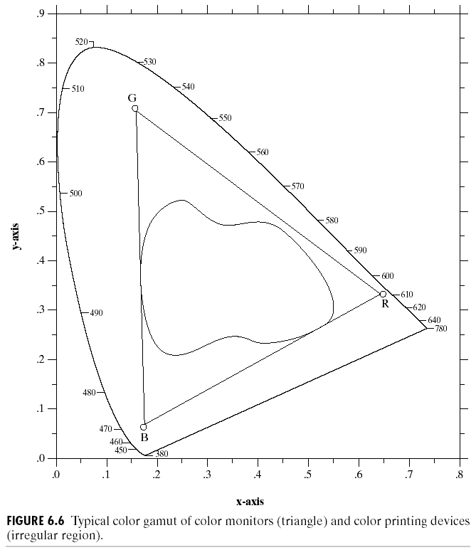
Color Fundamentals
The combination of RGB cannot generate all colors!
11
Notes:
The irregular region inside the triangle is representative of the today’s high quality color printing devices

Slide 12
Color Models
Purpose of color models
Facilitate the specification of colors in some standard, generally accepted way.
Categorization
Hardware-oriented (color monitors and printers)
RGB : color monitors and color video cameras
CMY (cyan, magenta, yellow) or CMYK (cyan, magenta, yellow, black) : color printing
Application-oriented (color manipulation)
HSI (hue, saturation, intensity )
color and gray-scale information are decoupled;
many gray-scale techniques can be used!
12
Notes:
[ˈsaɪən] 青色
[mə‘dʒentə] 品红

Slide 13
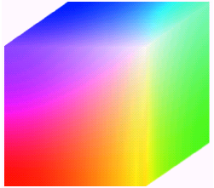
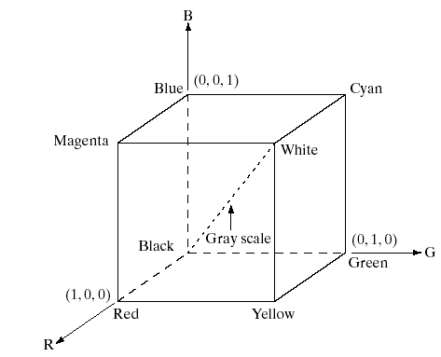
Color Models
The RGB color model
Three image planes, each usually 8-bit per pixel
Full-color: 24-bit RGB color image, representing (2⁸)³ colors!
13

Slide 14
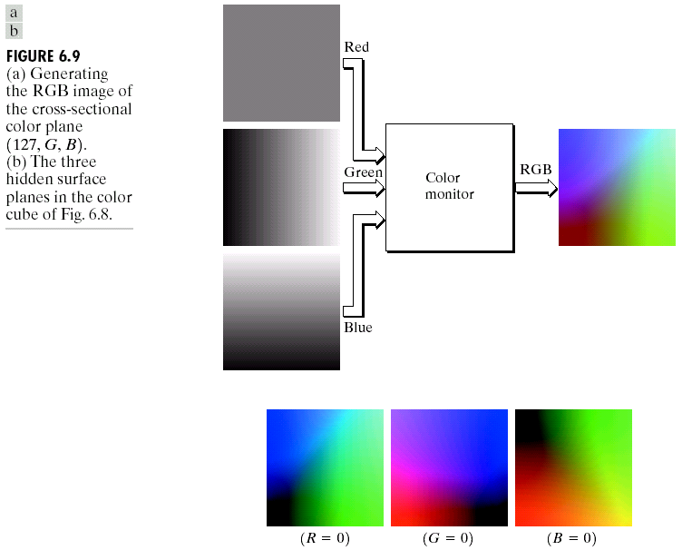
Color Models
14

Slide 15
Color Models
The CMY and CMYK color model
Most devices that deposit colored pigments on paper require CMY input or perform an RGB to CMY conversion:
Why CMYK model?
Black can be generated by equally combining CMY, while it is muddy-looking!
Fourth color, black, is added to CMY
15

Slide 16
Color Models
The HSI color model
Problems with the RGB and the CMY/CMYK models.
not well suited for human interpretation! We cannot identify the percentage of composite colors.
HSI (hue, saturation, intensity) is better
natural and intuitive to human interpretation
decouple intensity component from color-carrying information (hue and saturation)
ideal tool for developing image processing algorithms
16

Slide 17
Color Models
The HSI color model (Cnt’d)
Converting colors from RGB to HIS
17

Slide 18
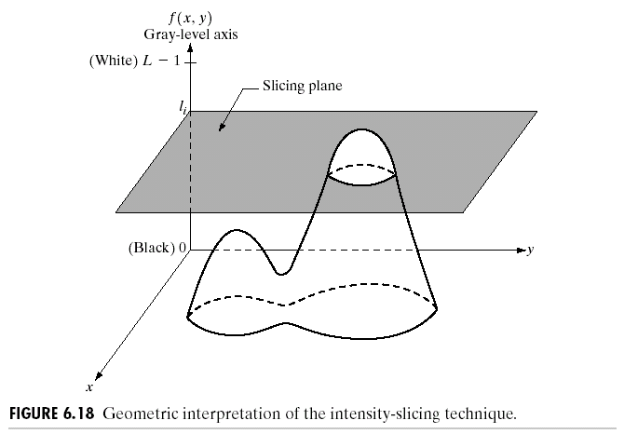
Pseudocolor Image Processing
Purpose
For human visualization and interpretation of gray-scale events in an image or sequence of images.
Human can discern:
thousands of colors vs. only two dozen gray levels
Intensity slicing
18

Slide 19
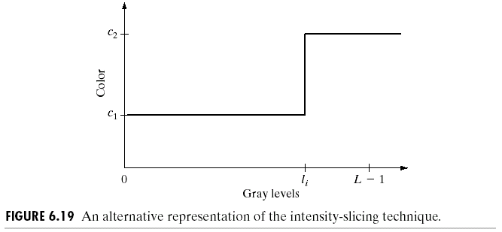
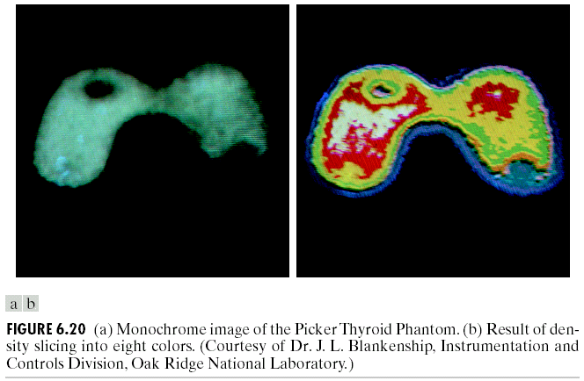
Pseudocolor Image Processing
19
Notes:
[ˈmɔnəˌkrəʊm]

Slide 20
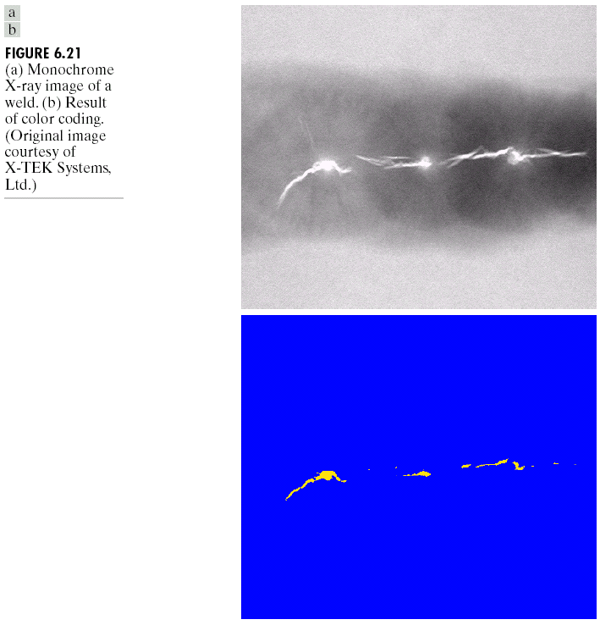
Pseudocolor Image Processing
20

Slide 21
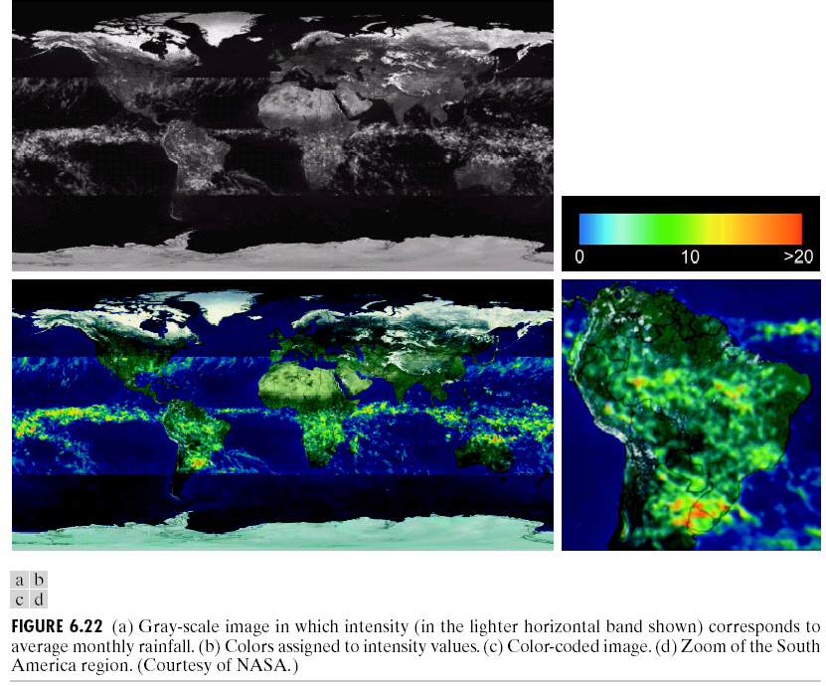
Pseudocolor Image Processing
21

Slide 22
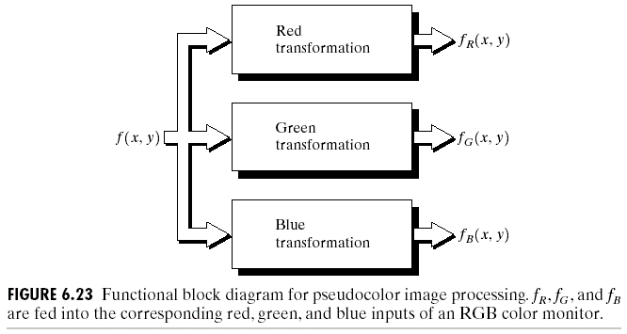
Pseudocolor Image Processing
Gray level to color transformations
For single image
three independent transformations on gray levels
final colors are determined by the transformations
22

Slide 23
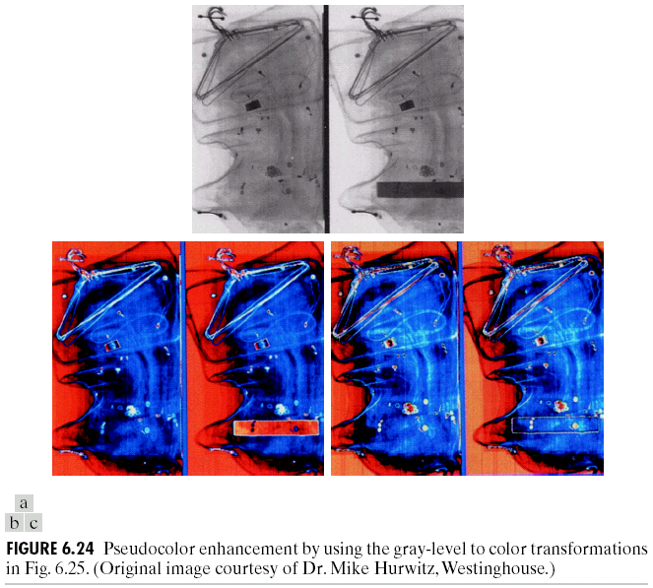
Pseudocolor Image Processing
Gray level to color transformations
23
Notes:
Pseudocolor [sju:dəʊ'kɒlər]

Slide 24
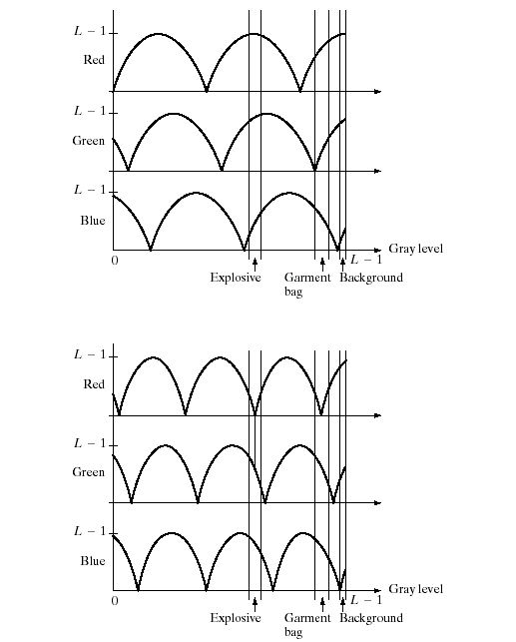
Pseudocolor Image Processing
24

Slide 25
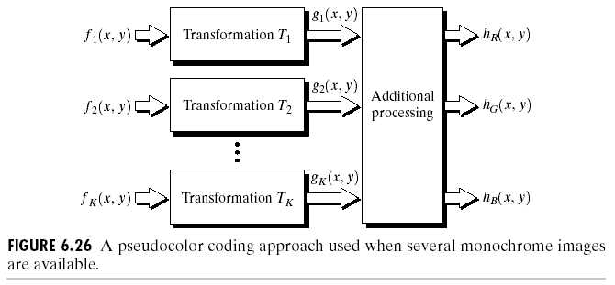
Pseudocolor Image Processing
Gray level to color transformations
For multiple images (especially for multispectral images)
Knowledge on the response characteristics of the sensors is important for combining the images!
25

Slide 26
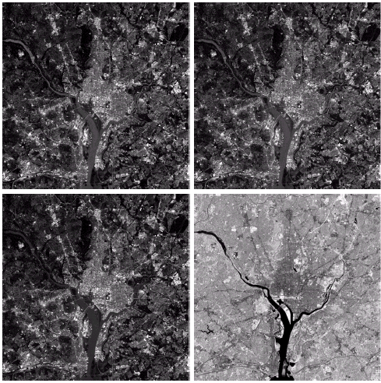
Pseudocolor Image Processing
26

Slide 27
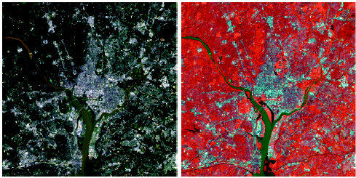
Pseudocolor Image Processing
27

Slide 28
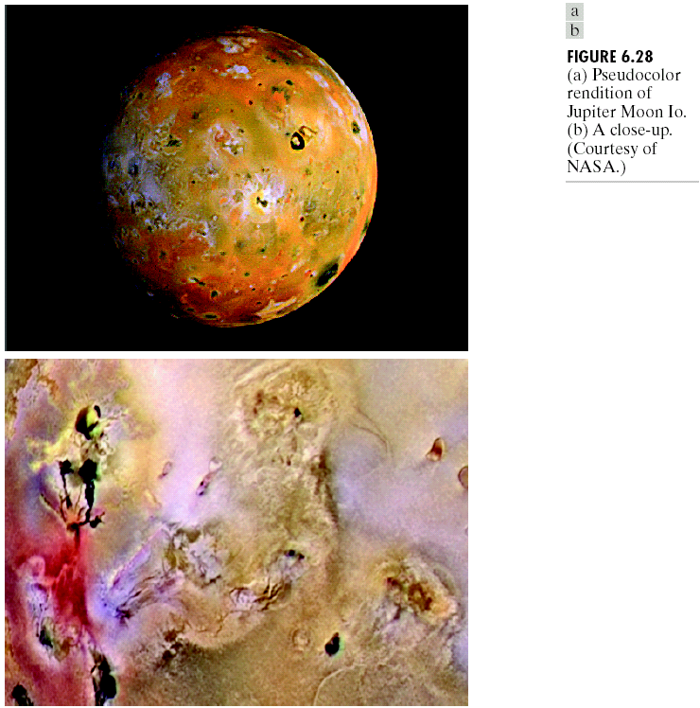
Pseudocolor Image Processing
28

Slide 29
Basics of Full-Color Image Processing
Major categories for full-color image processing
First category:
process each component image individually, and then form a composite processed color image from the individually processed components
Second category:
work with color pixels directly
Major considerations – vector-based processing
29

Slide 30
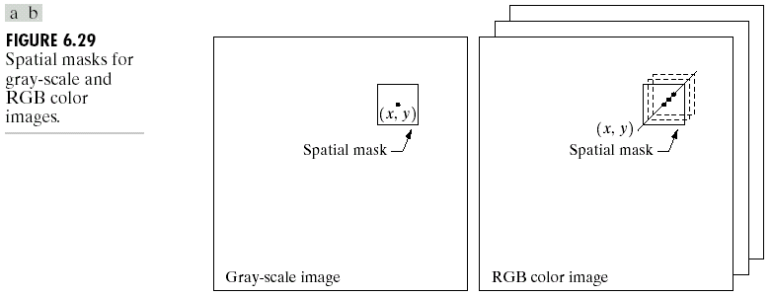
Basics of Full-Color Image Processing
Major considerations – vector-based processing (Cnt’d)
approaches?
30

Slide 31
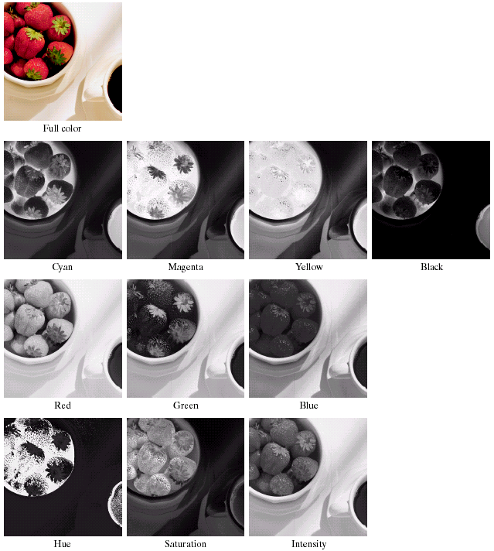
Color Transformations
Example:
Color components
31

Slide 32
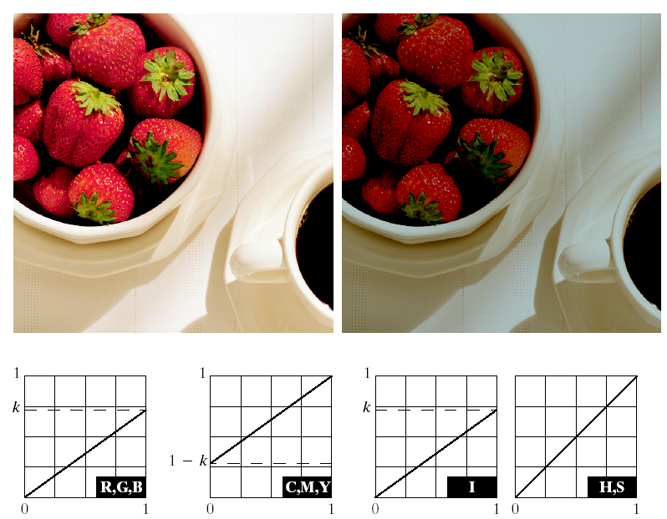
Color Transformations
Example:
Adjusting the intensity of an image
32

Slide 33
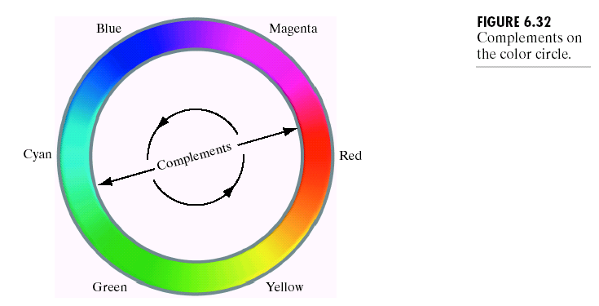
Color Transformations
Color complements
color circle
the hues directly opposite one another on the color circle are called complements
33

Slide 34
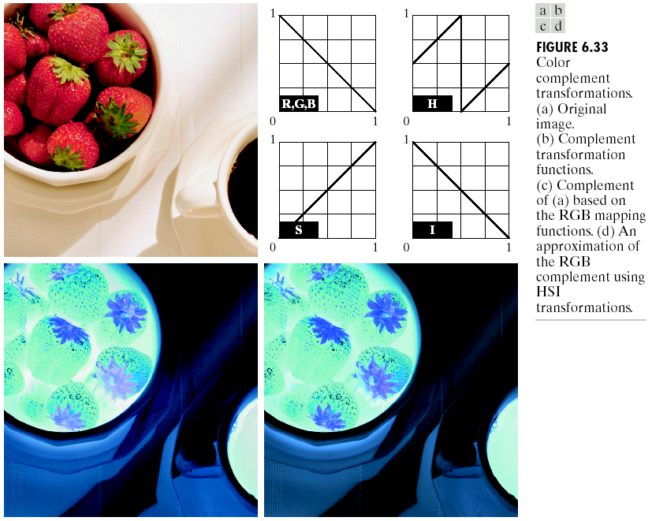
Color Transformations
Color complements
34

Slide 35
Color Transformations
Color slicing
purpose
display the colors of interest so that they stand out from the background;
use the region defined by the colors as a mask for further processing
approaches
colors of interest are enclosed by a cube
35

Slide 36
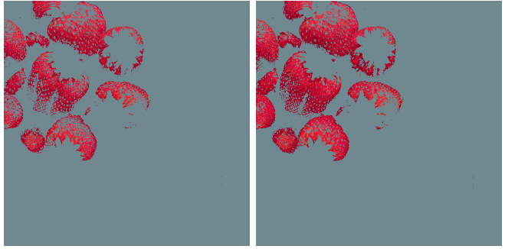
Color Transformations
Color slicing
approaches (Cnt’d)
colors of interest are enclosed by a sphere
36

Slide 37
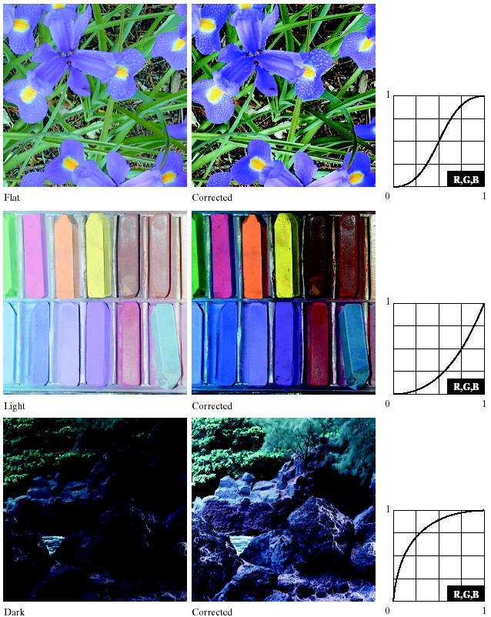
Color Transformations
Tone and color corrections
tonal corrections
37

Slide 38
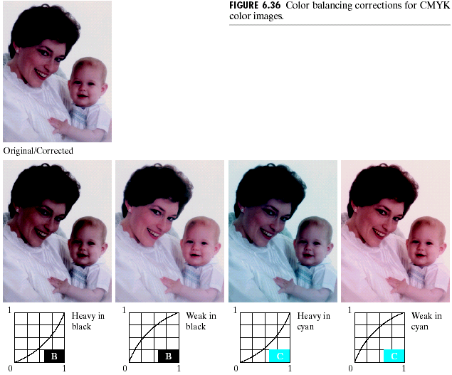
Color Transformations
Tone and color corrections
color balancing
38

Slide 39
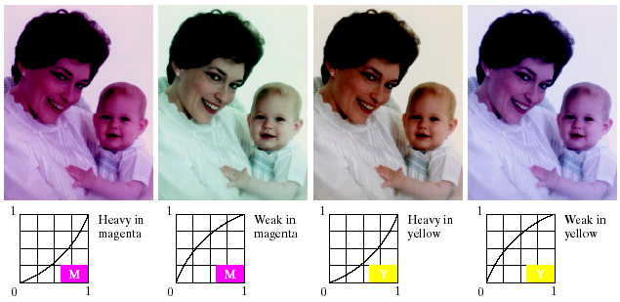
Color Transformations
Tone and color corrections
color balancing
39

Slide 40
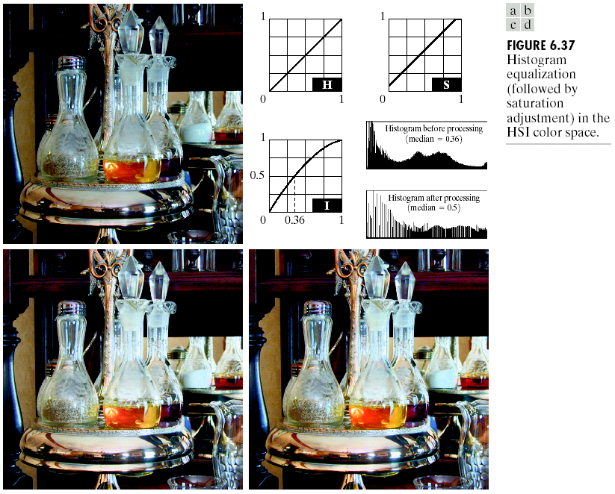
Color Transformations
Histogram processing
Spread the color intensities uniformly, leaving the colors themselves (e.g. hues) unchanged!
40

Slide 41
Smoothing and Sharpening
Color image smoothing
per-color-plane basis
intensity component basis
41

Slide 42
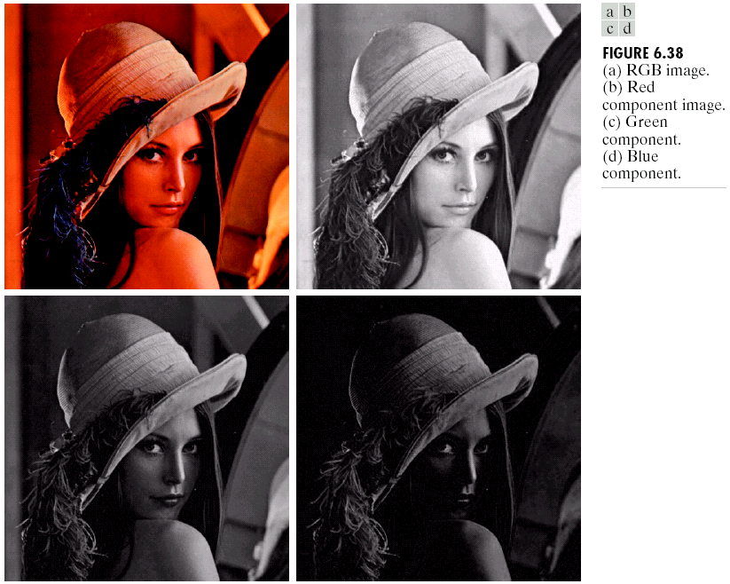
Smoothing and Sharpening
Color image smoothing
42

Slide 43
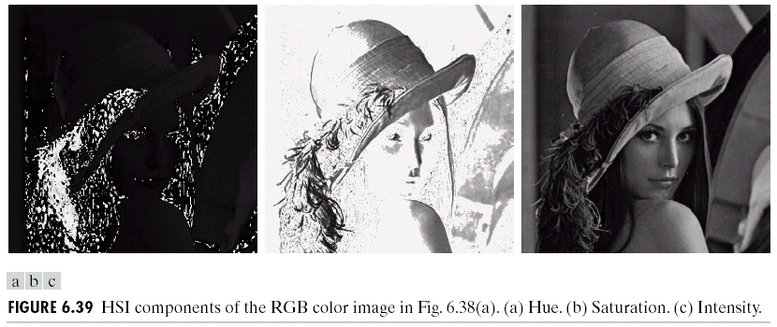
Smoothing and Sharpening
Color image smoothing
43

Slide 44
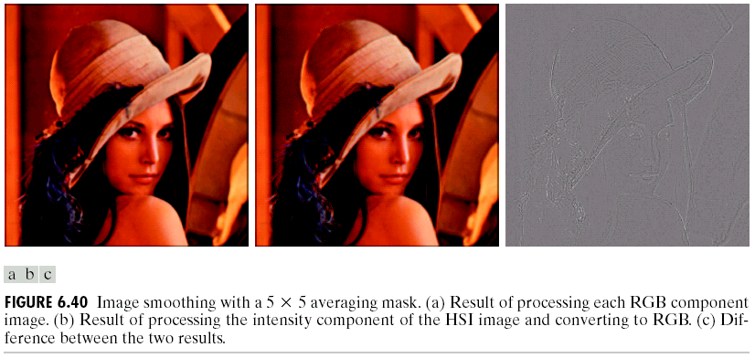
Smoothing and Sharpening
Color image smoothing
44

Slide 45
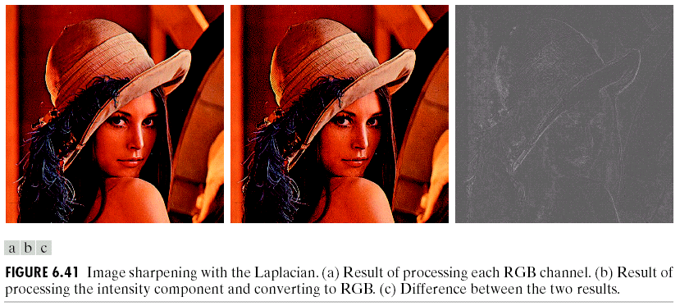
Smoothing and Sharpening
Color image sharpening
Laplacian of color vector:
45

Slide 46
Color Segmentation
Segmentation in HIS color space
Color is conveniently represented in the hue image
saturation is used as a masking image in order to isolate further regions of interest in the hue image;
Why? Any physical meaning?
intensity image is used less frequently for segmentation of color images because it carries no color information
46

Slide 47
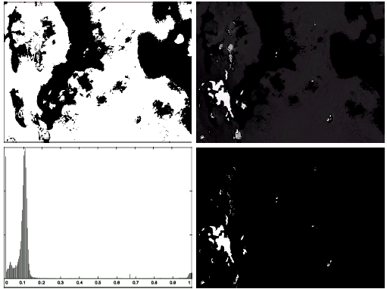
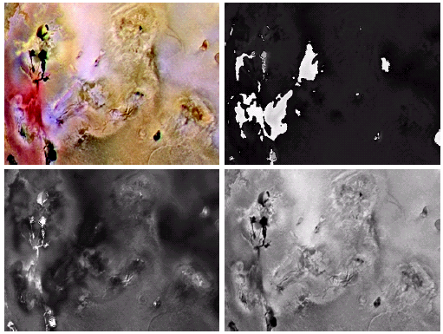
Color Segmentation
47

Slide 48
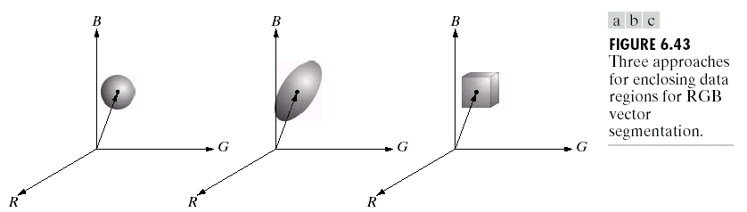
Color Segmentation
Segmentation in RGB vector space
Pixel similarity defined in RGB space:
48

Slide 49
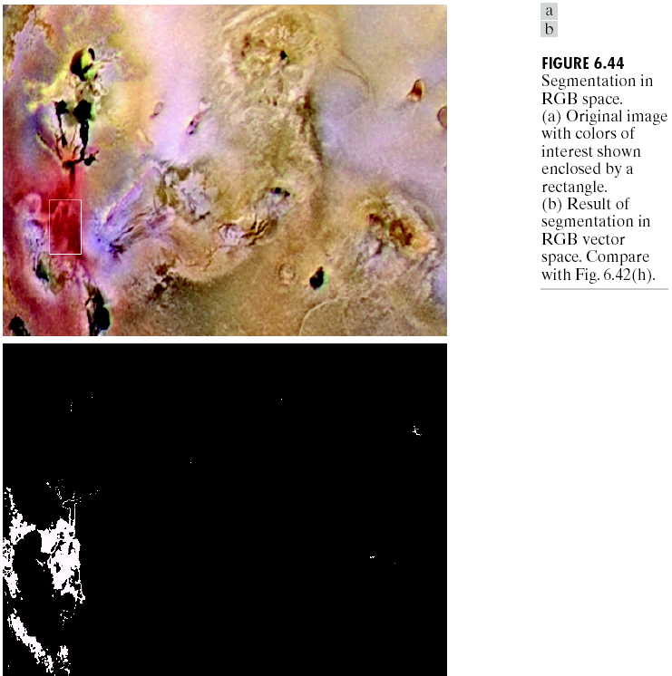
Color Segmentation
Segmentation in RGB vector space
49

Slide 50
Summary
In this lecture, we have learned
Color Fundamentals
Color Models
Pseudocolor Image Processing
Color Transformations
Smoothing and Sharpening
Color Segmentation
50

